Slide 1
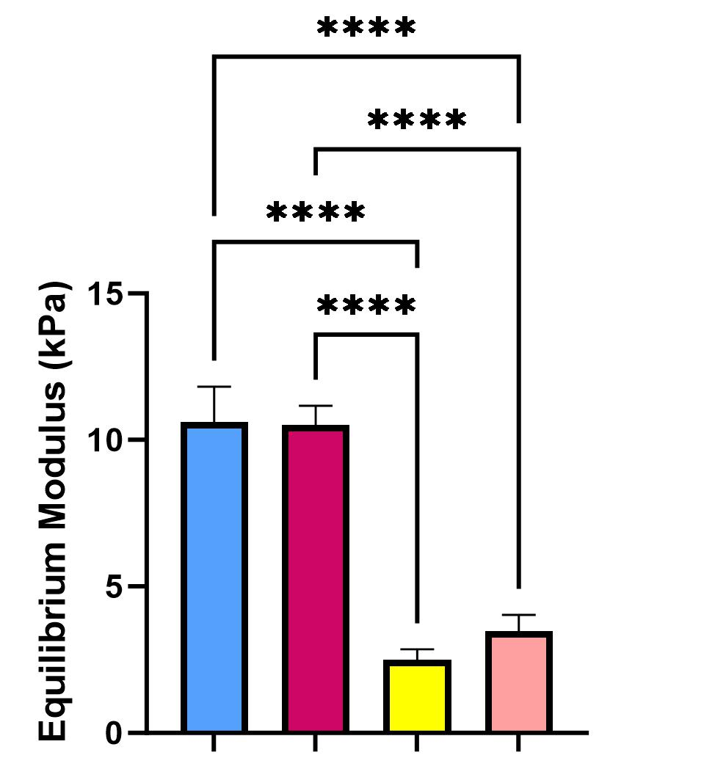
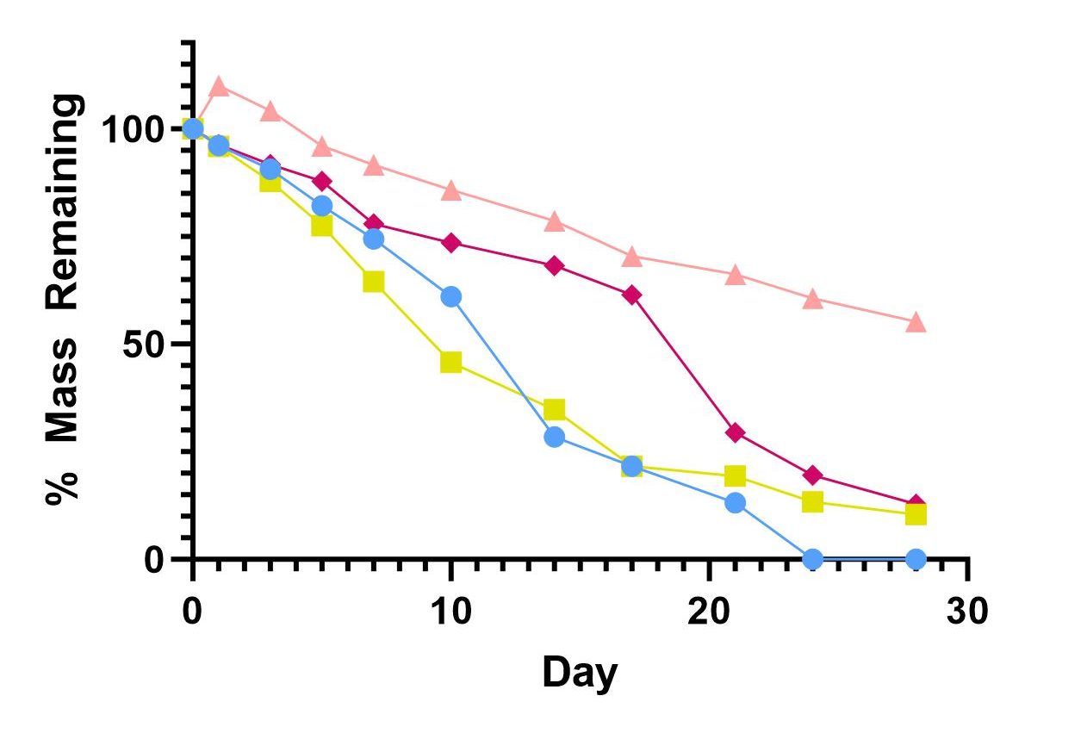
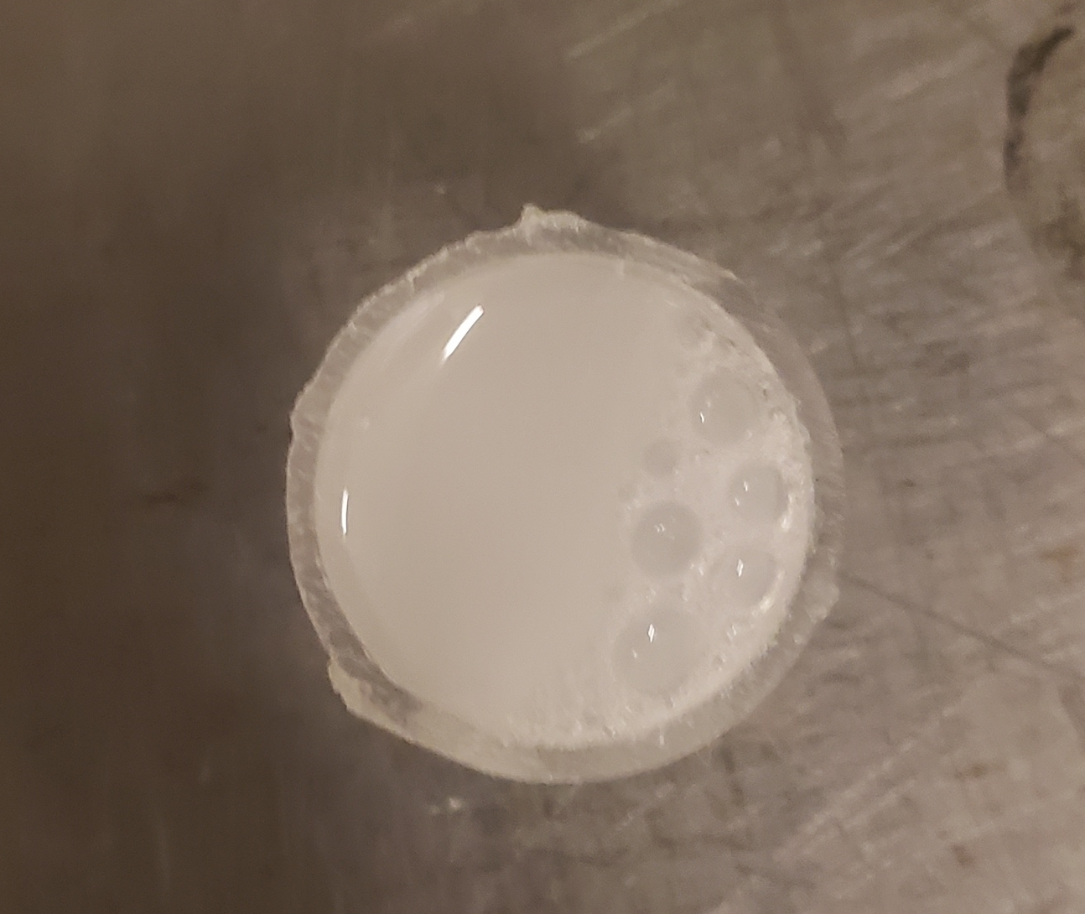
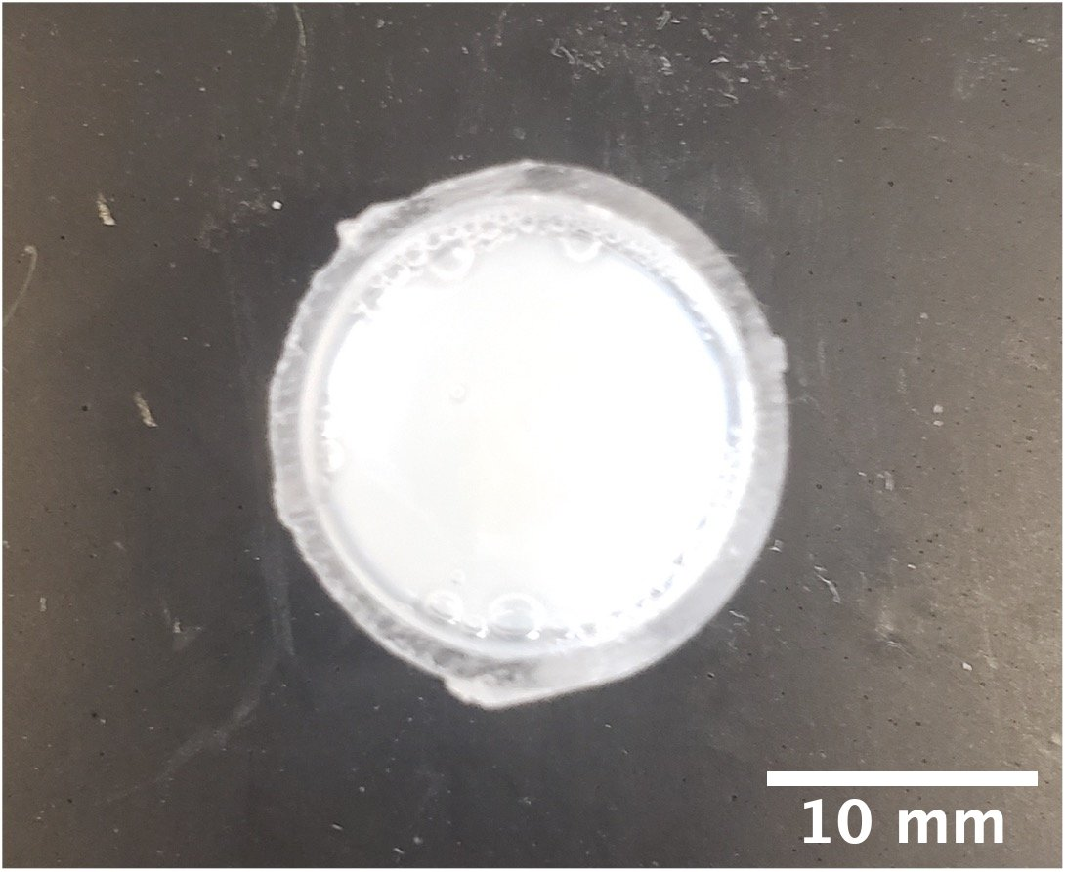
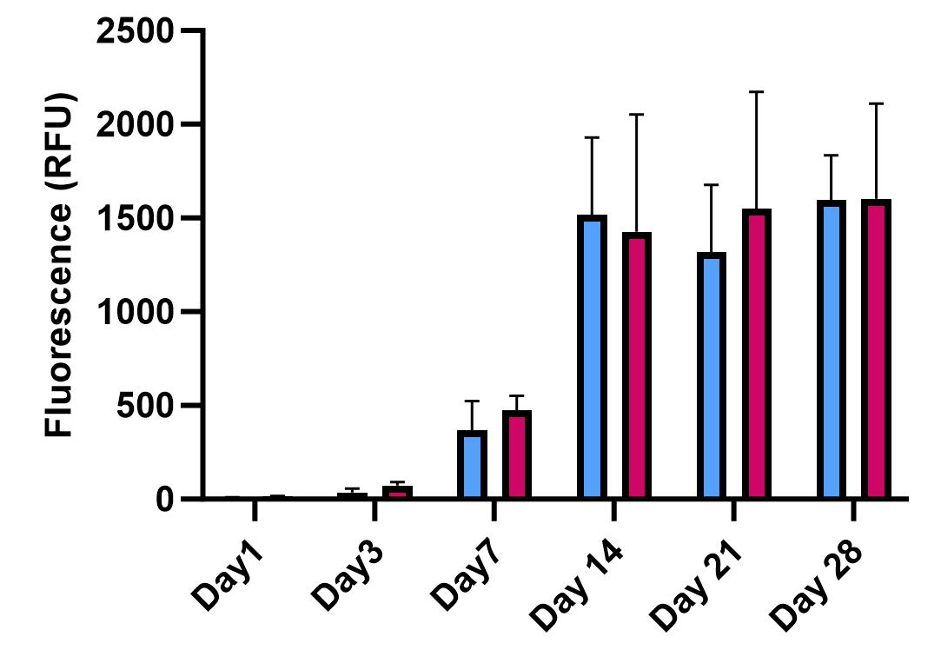
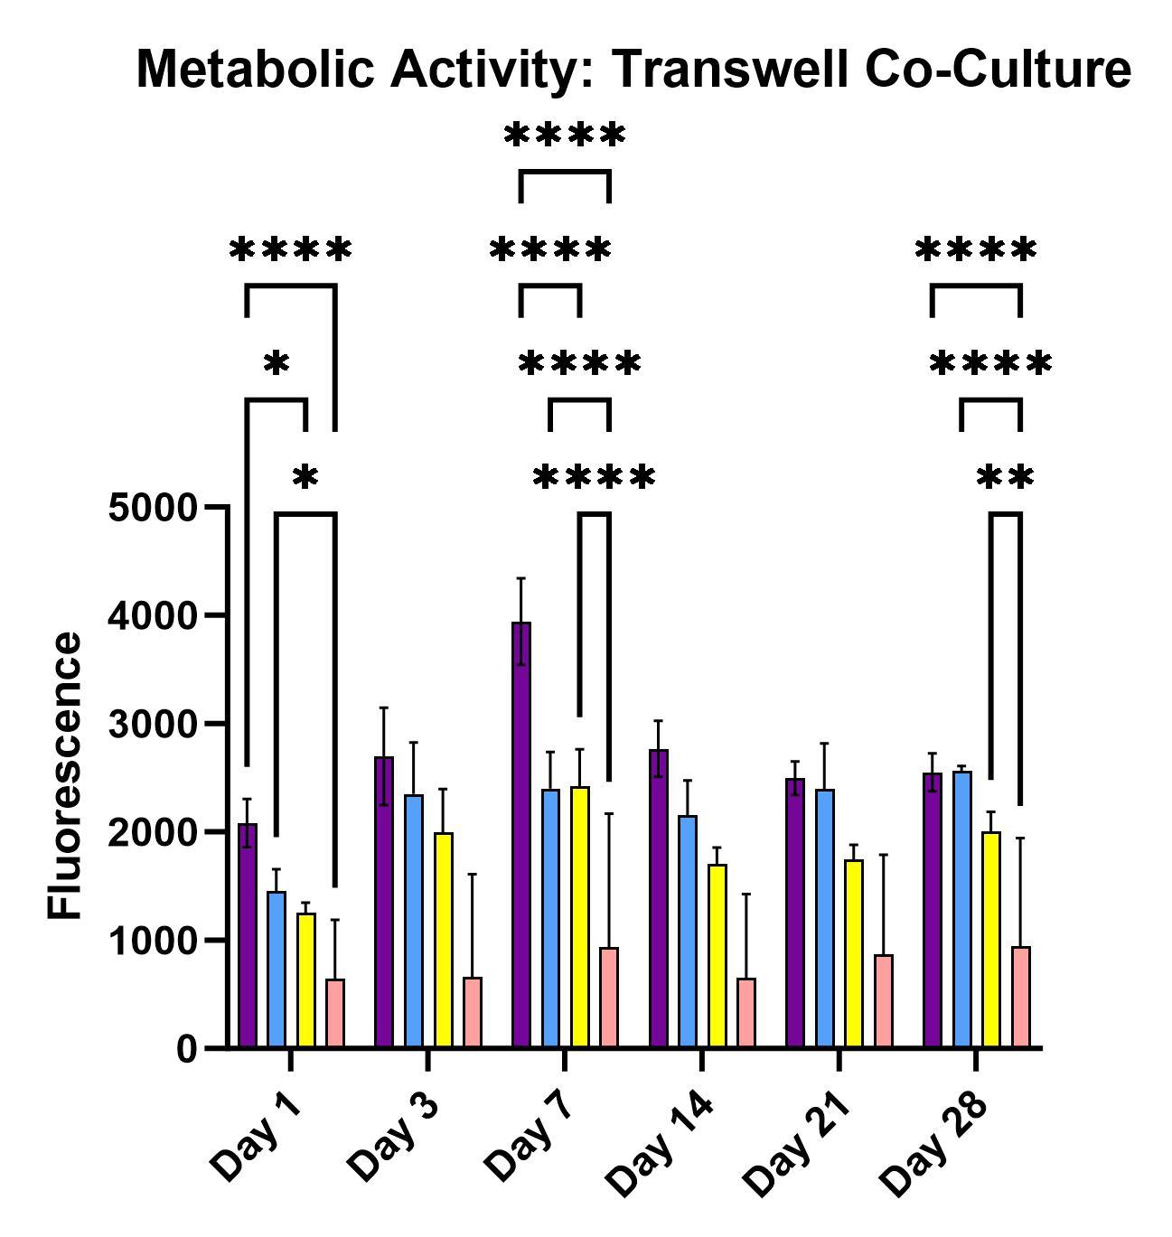
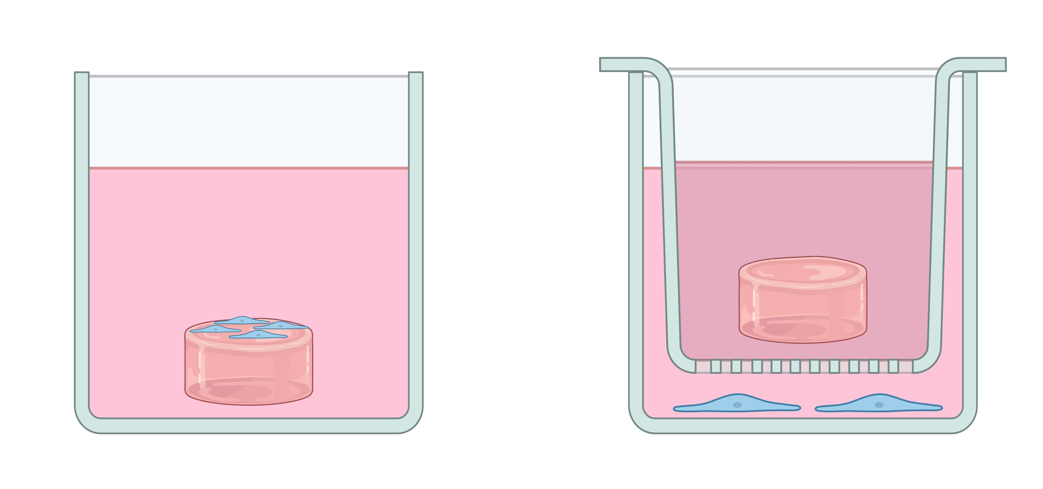

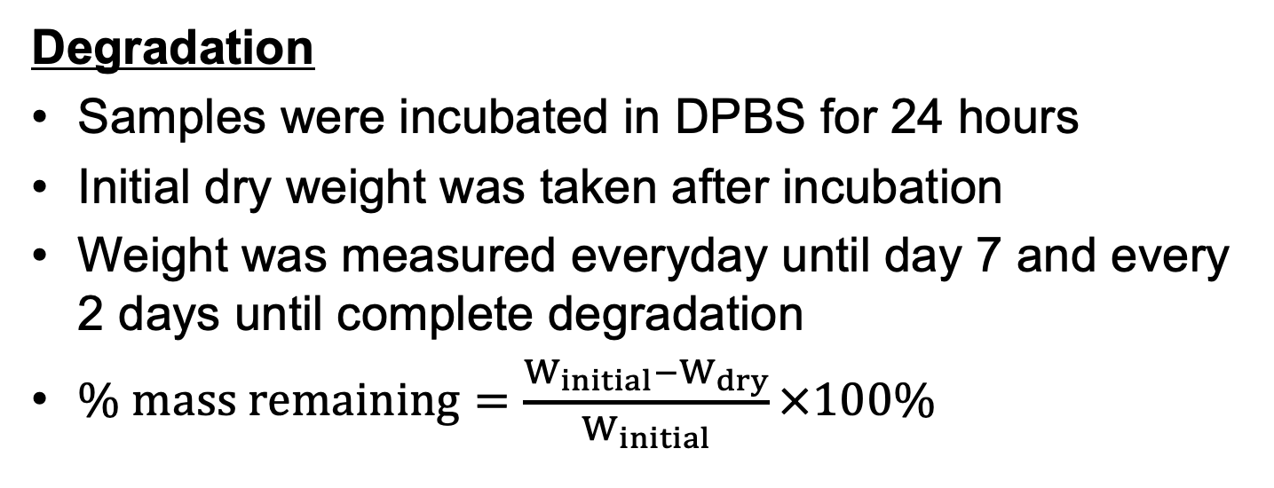


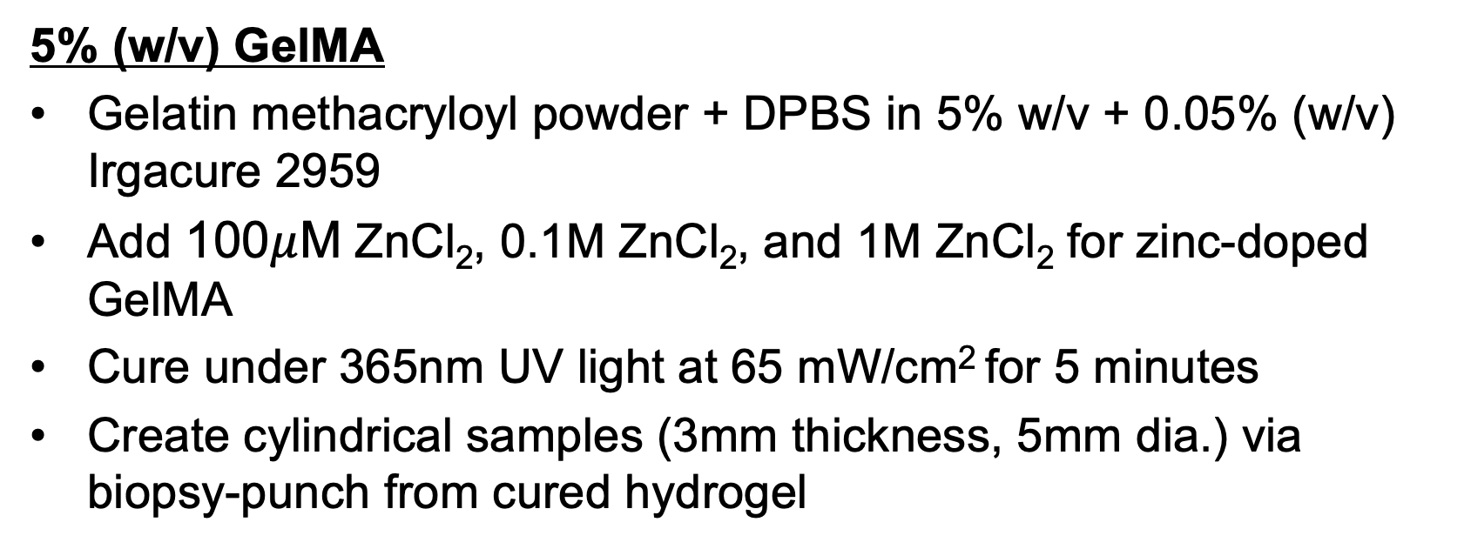
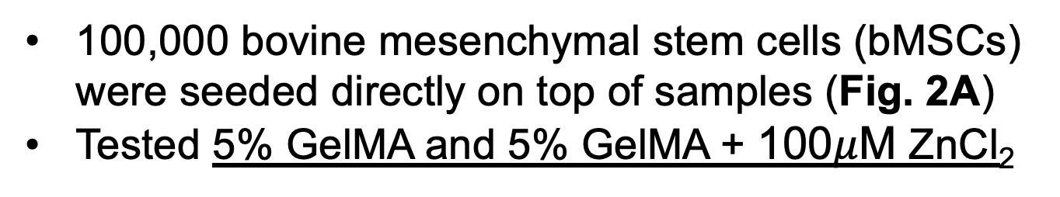
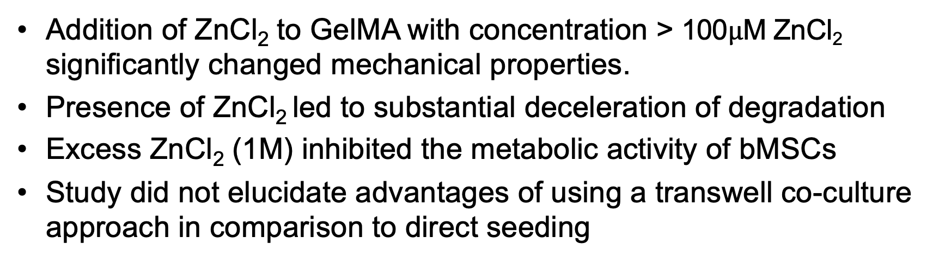
Temporal Zinc Release from Hydrogels: Effects on Mechanics, Metabolic Activity, and Gene Expression
Xuanbei Pan¹, Stephen Ching¹, Hisham Omar², Paulina Bargalló González Lugo¹, and Michael W. Hast²
1) McKay Orthopaedic Research Laboratory, University of Pennsylvania, Philadelphia, PA
2) Departments of Mechanical and Biomedical Engineering, University of Delaware, Newark, DE
Introduction
Results
Localized delivery of zinc at surgical fracture fixation sites has promising therapeutic potential:
Zinc delivery via oral ingestion, injection, and nanoparticle carriers were shown to enhance osteoblast differentiation and inhibit osteoclast differentiation [1]
Zinc upregulates ALP, COL1A, and RUNX2 via cAMP-PKA-CREB signaling pathway [2]
Gelatin methacryloyl (GelMA) is a photocrosslinkable hydrogel that is biocompatible, biodegradable, and has tunable mechanical properties [1]
A.
Mechanical Testing
B. Degradation Kinetics
Legend
5% GelMA
Knowledge Gap: Is GelMA an effective vehicle to provide sustained release of zinc at a fracture site?
Objective: Determine changes in degradation kinetics and osteogenic effects caused by differences in zinc dosage and method of application (direct seeding v. transwell co-culture)
Hypotheses:
Addition of ZnCl₂ to GelMA will not significantly change its degradation kinetics or mechanical properties
Increased dosage of ZnCl₂ improves metabolic activity
5% GelMA + 100$μ$M ZnCl₂
5% GelMA + 0.1M ZnCl₂
5% GelMA + 1M ZnCl₂
bMSC (control for transwell co-culture)
Fabrication of GelMA
5% (w/v) GelMA
Gelatin methacryloyl powder + DPBS in 5% w/v + 0.05% (w/v) Irgacure 2959
Add 100$μ$M ZnCl₂, 0.1M ZnCl₂, and 1M ZnCl₂ for zinc-doped GelMA
Cure under 365nm UV light at 65 mW/cm² for 5 minutes
Create cylindrical samples (3mm thickness, 5mm dia.) via biopsy-punch from cured hydrogel
C. Metabolic Activity Direct Seeding
D. Metabolic Activity Transwell
Figure 1. Left: 5% GelMA + 0.1M ZnCl₂. Right: 5% GelMA + 1M ZnCl_{2.}
Mechanical Testing/Degradation
Unconfined Compression
Creep test at 4.9 N for 300 seconds
Stress relaxation following creep test for 1000 seconds
Cyclic loading to 1% of sample thickness at 0.5 Hz for 10 cycles
Equilibrium modulus calculated from creep strain and stress from stress relaxation
Degradation
Samples were incubated in DPBS for 24 hours
Initial dry weight was taken after incubation
Weight was measured everyday until day 7 and every 2 days until complete degradation
$\% mass remaining=\frac{W_{initial}−W_{dry}}{W_{initial}}×100\%$
In Vitro Studies
Figure 3. A) Equilibrium moduli was unaffected by 100$μ$M concentrations of ZnCl₂ but significant losses were observed at higher concentrations. B) The 28-day degradation study that showed that inclusion of ZnCl₂ decelerated degradation kinetics. C) Metabolic activity for 5% GelMA and 5% GelMA + 100$μ$M ZnCl₂, where bMSCs were directly seeded onto the GelMA samples. There were no significant differences between groups. D) Metabolic activity for bMSC control, 5% GelMA, 5% GelMA + 0.1M ZnCl₂ and 5% GelMA + 1M ZnCl₂, where GelMA samples co-cultured with bMSCs and did not directly contact cells. Note: Significance only shown for Day 1,3,28 for for panel D. *p<0.05, ***p<0.001, ****p<0.0001.
Approach 1: Direct Seeding
A.
B.
100,000 bovine mesenchymal stem cells (bMSCs) were seeded directly on top of samples (Fig. 2A)
Tested 5% GelMA and 5% GelMA + 100$μ$M ZnCl₂
Conclusions
Approach 2: Transwell Co-culture
Addition of ZnCl₂ to GelMA with concentration > 100$μ$M ZnCl₂ significantly changed mechanical properties.
Presence of ZnCl₂ led to substantial deceleration of degradation
Excess ZnCl₂ (1M) inhibited the metabolic activity of bMSCs
Study did not elucidate advantages of using a transwell co-culture approach in comparison to direct seeding
Future Directions
This work was preliminary in nature
Conduct RT-qPCR for transwell co-culture approach
Explore 3D printed zinc-doped GelMAs
Define uses for zinc-doped GelMAs in combination with other biomaterials through in vitro and vivo studies
100,000 bMSCs were seeded on the bottom chambers of 12-well plates
5% GelMA, 5% GelMA + 0.1M ZnCl₂, 5% GelMA + 1M ZnCl₂ samples were placed in the transwell insert (Fig. 2B)
Figure 2. A) Schematic of approach 1: direct seeding of bMSCs on GelMA sample. B) Schematic of approach 2: hydrogel in transwell insert and bMSCs seeded on well bottom.
Metabolic Activity
bMSCs were cultured in DMEM (+10% FBS, 1% Penicillin-streptomycin)
Alamar blue assays were conducted on day 1, 3, 7, 14, 21, and 28
Measured fluorescence at 560-590 nm wavelength
RT-qPCR
RT-qPCR conducted on day 7 and 28
Measure relative gene expression of ALP and COL1a, with GAPDH as housekeeping gene
No significant results (not shown)
References & Acknowledgements
Visit our website!
References: [1] M. Sun, et al., Polymers, 2018. [2] K.H. Park, et al., Stem Cells and Development, 2018.
Acknowledgments: This study was supported by NIH NIAMS K25AR078383, R03AR082449 and P30AR069619
Contact us: xuanbeip@seas.upenn.edu; hast@udel.edu; url: www.sites.udel.edu/hastlab
Notes:
Common issues with fraction fixation surgery include nonunion (when the bone fails to heal properly) and fixation failure.
My research hopes to locally deliver zinc to fraction fixation sites in order to prevent the issues mentioned before.
Zinc is an essential mineral that have been shown to enhance osteoblast differentiation and inhibit osteoclast differentiation, all of which enhances bone regeneration process
I attempted to achieve localized zinc delivery using a biomaterial-approach, with a hydrogel called GelMA

